Slide 1


Switchboard – Load Center – Power Panel Capacity Sizing Electric Power Load Analysis (EPLA) Revision of 2 May 2026
Dr. Norbert Doerry
http://doerry.org/norbert/MarineElectricalPowerSystems/index.htm
© 2026 by Norbert Doerry This work is licensed via: CC BY 4.0 (https://creativecommons.org/)

Slide 2
Essential Questions
What are the different load analysis methods applicable to determine switchboard, load center, and power panel capacity? | Understand
What are the impacts of non-fundamental frequency components and common mode components of load currents on switchboard, load center, and power panel capacity? | Understand
How should additional loads from automatic bus transfer switches transferring loads be considered in establishing switchboard, load center, and power panel capacity? | Understand

Slide 3
Introduction
Power Panel
(Photo by Norbert Doerrry)
Rating of switchboard – load center – power panel bus bars is based on the maximum operating current through the bus bars.
The maximum operating current through a load center or power panel is generally determined by the loads connected to it.
The maximum operating current for a switchboard also depends on the flow of current through bus ties.
Current can flow in one bus-ties and out another bus-tie.
Operating load (kVA or KW) and current (A) can be calculated from one another using the nominal system voltage and assumed power factor.
Switchboard
(Image is in the public domain)
Load Center
(U.S. Navy Photo)

Slide 4
Load Factor Analysis
Assumes many loads where variation of the total load around the mean is small.
Usually applicable at the total ship level
Switchboards, load centers, and power panels usually only serve a subset of the total load
The variation of the total load around the mean is relatively larger
Extended periods of time in an overload may result in damage due to overheating
Energy storage that only powers the connected switchboard, load center or power panel should be considered a load with the appropriate charging power.
Energy storage that can power other connected switchboards, load centers or power panels should be examined as both a source and a load.
Method described in IEEE Std. 45.1 and in DPC 310-1.

Slide 5
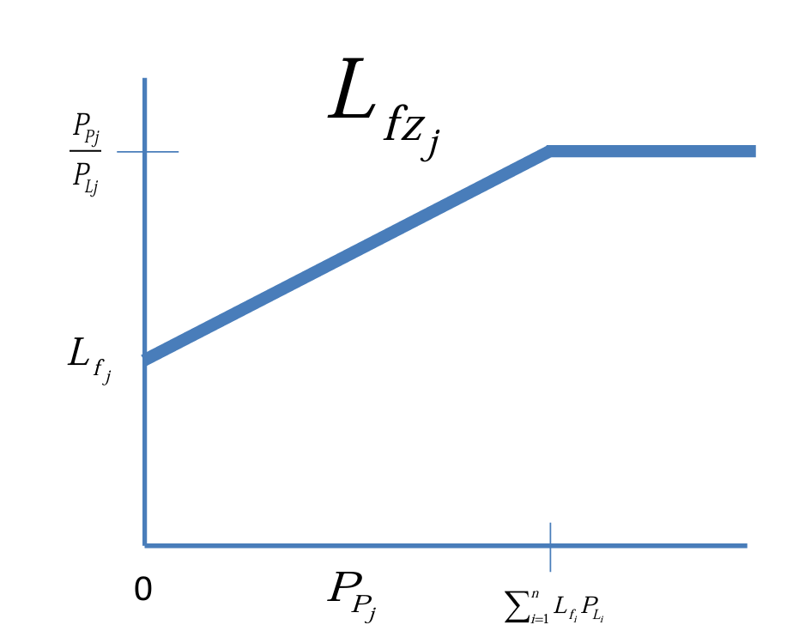
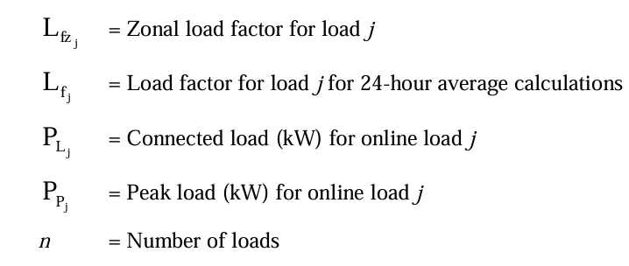
Zonal Load Factor Analysis
Zonal load factors account for variability in the total load due to having non- constant power loads
Almost always results in a larger operating load as compared to the traditional load analysis
Reduces risk of overloading distribution equipment
Method described in DPC 310-1
From DPC 310-1

Slide 6
Demand Factor Analysis
Legacy method
Useful in early-stage design for determining power rating of distribution equipment and cable conductor size.
Other methods should be used in Preliminary design or later
Demand factor obtained from curve based on connected load
Required rating is the total connected load multiplied by the demand factor
From DPC 310-1
From DPC 310-1

Slide 7
Load Flow Analysis
Steady-state network simulation of the power system
May be used for determining the maximum operating current for a switchboard
Considers the impact of power (current) flow through the bus-ties.
Many cases must typically be analyzed to find the worst case
Vary which generator sets are online
Vary which particular loads of a group of identical loads are online

Slide 8
Limiting Load Flow Analysis
Early-stage design method.
Determines the upper bound for the maximum operating current.
Compares the maximum load connected to a switchboard to the maximum generation connected to it; the smaller number is the limiting load flow.
In some cases, multiple calculations may be necessary
The number of calculations is likely to be significantly less than for load flow analysis.

Slide 9
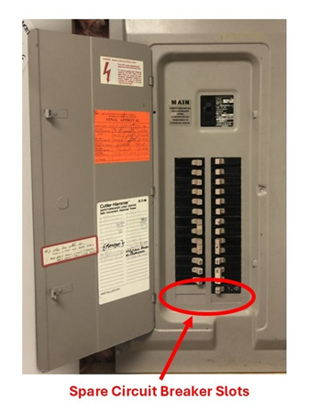
Margin and Service Life Allowance
Margin accounts for uncertainty in the operating load estimate during design and construction
IEEE Std 45.1 recommendation
Detail Design Margin: 5% for existing follow-on designs to 20% for new first-time designs
Construction Margin: 5% for existing follow-on designs to 20% for new first-time designs
Service life allowance (SLA) accounts for growth in load while the ship is in-service
IEEE Std 45.1 recommendation
20% (1% per year for 20 years)
Switchboards, load centers, and power panels should include provisions for incorporating additional loads or circuits
Spare circuit breakers
Allocation of slots into which circuit breakers may be plugged into
Space and weight allocation for an additional frame for circuit breakers

Slide 10
Harmonic and common mode currents
Non-fundamental (including harmonic) currents and common mode currents are potential source of additional heating.
Compounded by skin effect which effectively increases resistance at higher frequencies
Usually mitigated by increasing bus bar cross sectional area and controlling the shape of the bus bars.

Slide 11
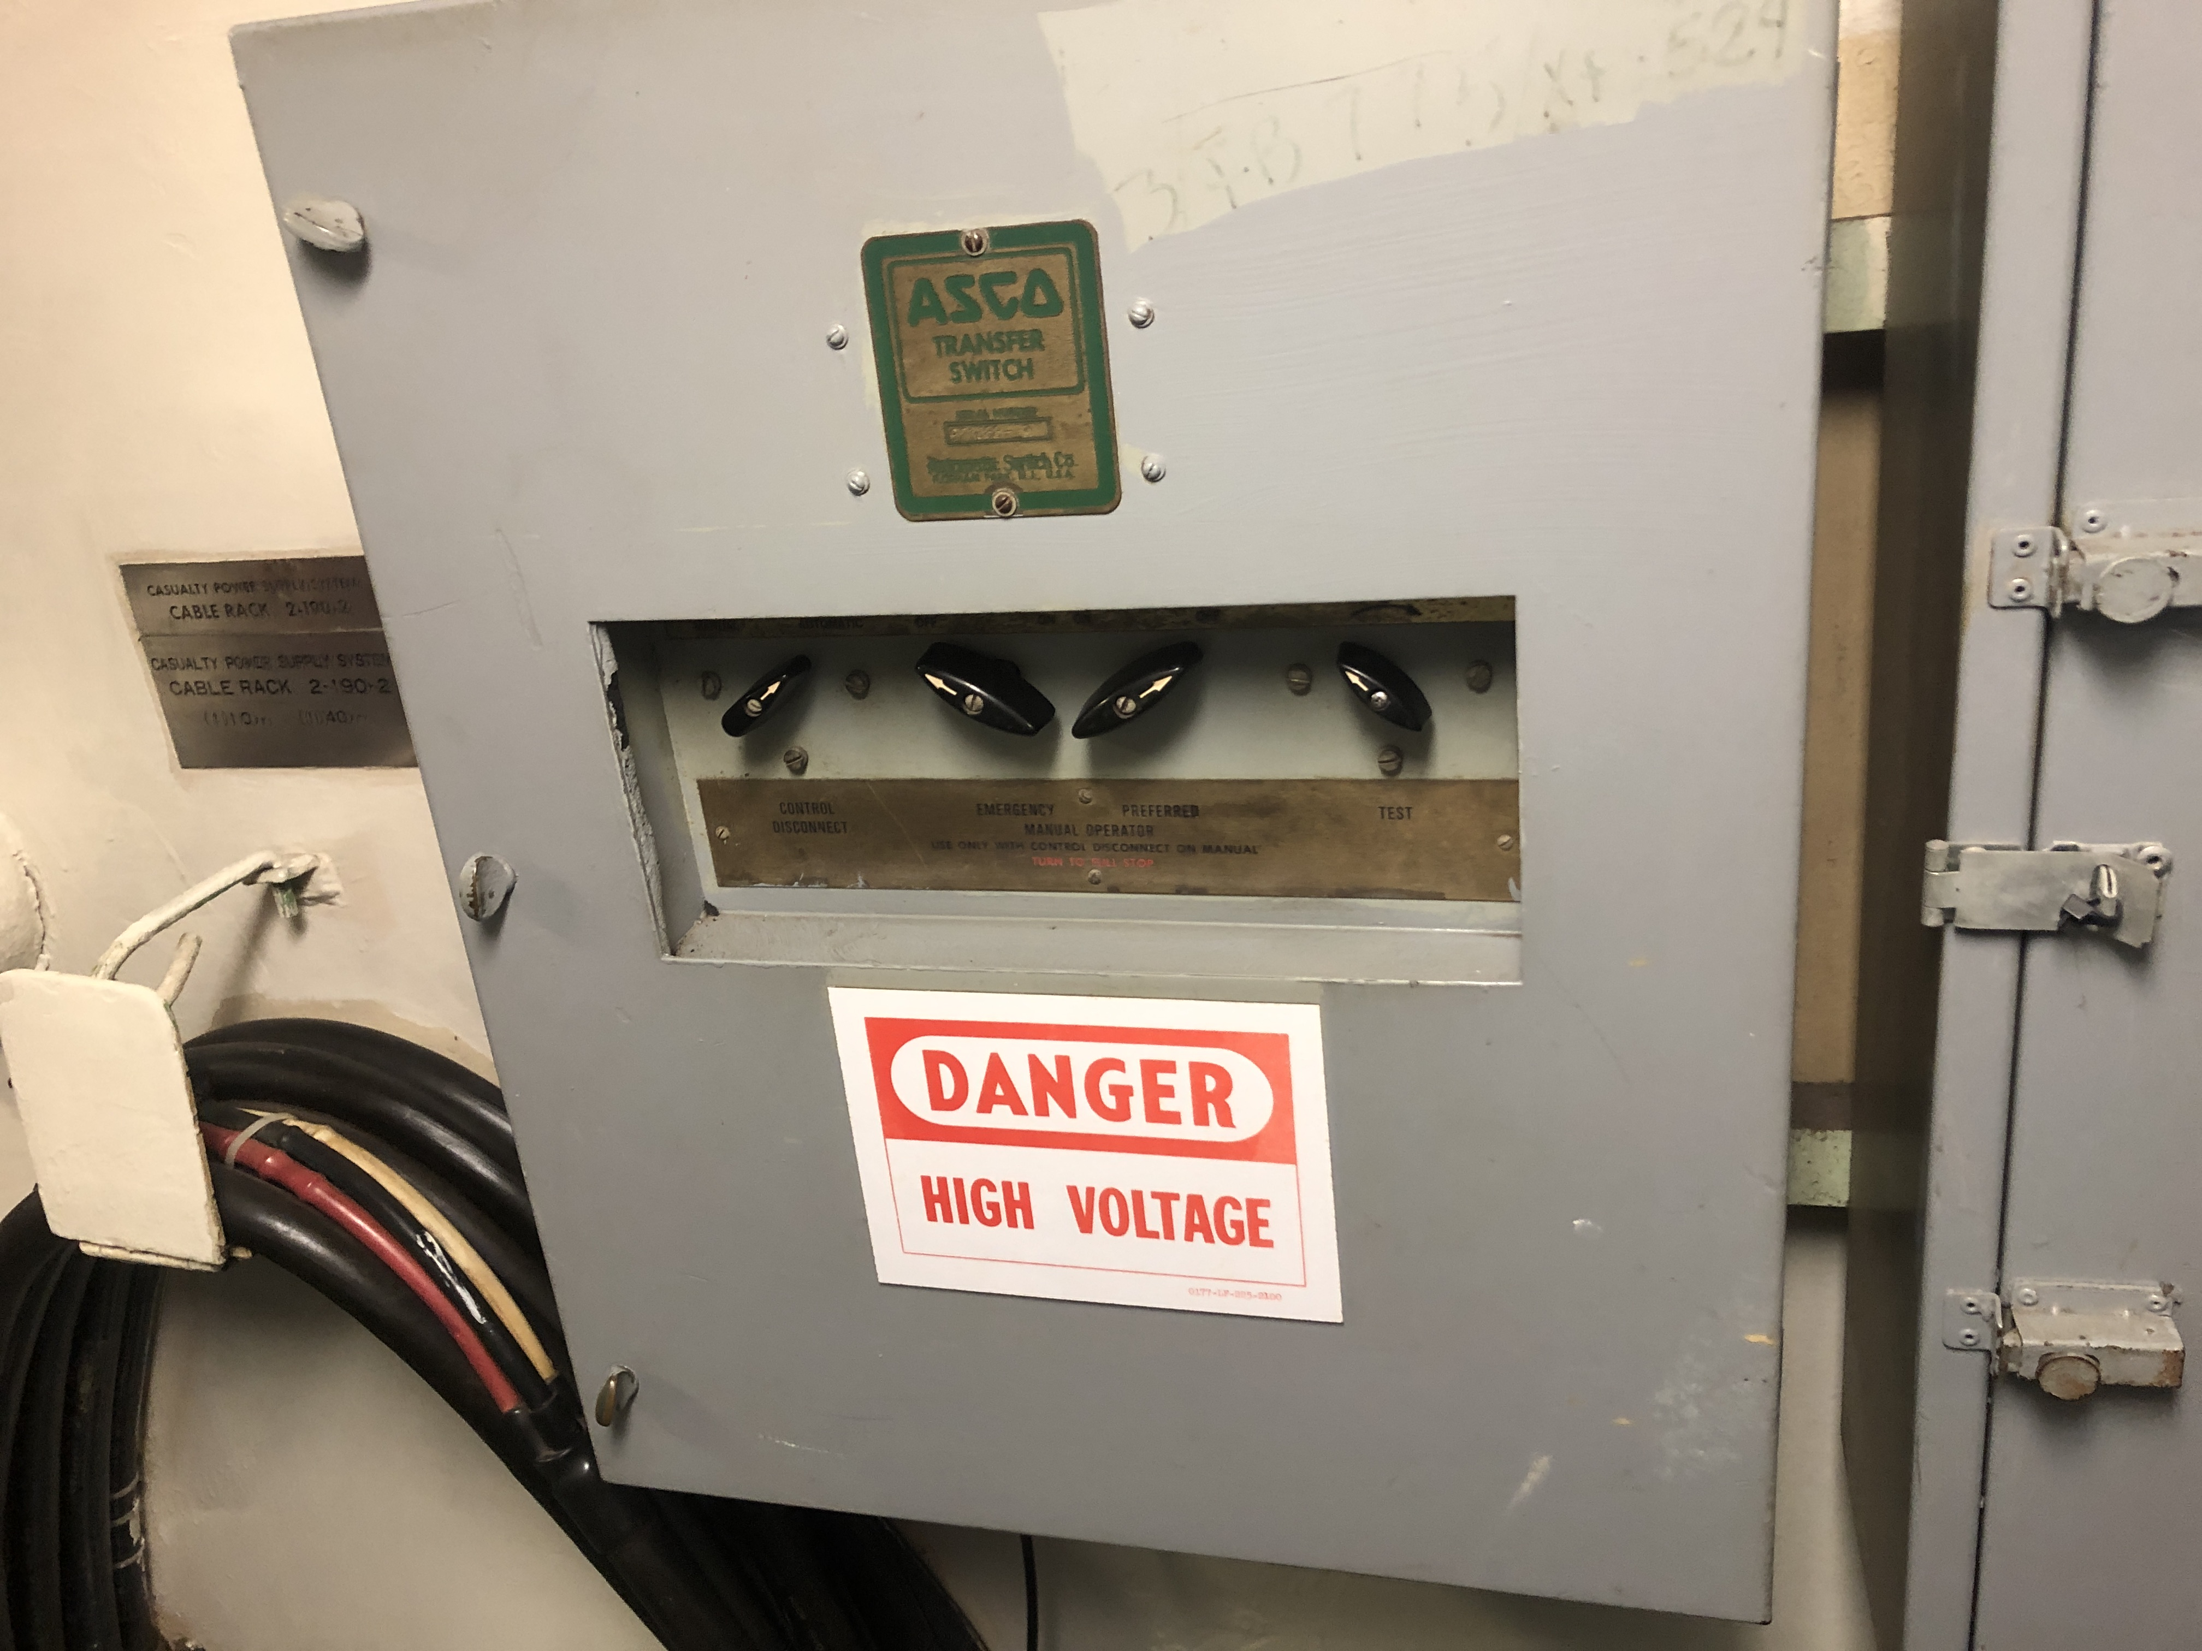
Survivability
Ratings of switchboards, load centers, and power panels should account for loads due to the action of bus transfers
Loads shifting from other switchboards, load centers, and power panels due to equipment failure, damage, or maintenance.
May require load shedding
Photo by Norbert Doerry

